Slide 1

Public Transport Optimization
ABHAS CHAUDHARI 30113659
PALLELA THARUN VENKAT 30113653
CHAVVAKULA SATYA VINAY 30113675
RAJASRI VADLA 30113535
NAKKA SARITHA 30113679
RAJOLI THRISHA REDDY 30113680

Slide 2

Why Public Transport Optimization Matters
The Challenge
Our Goal
Underutilized or overcrowded routes
Transform raw operational data into actionable insights, enabling data-driven scheduling and optimized resource allocation.
Inconsistent fuel efficiency
Low revenue per kilometer
Limited operational visibility

Slide 3


Tools & Technologies
Scala + Apache Spark
Distributed data processing for large-scale ETL operations.
PostgreSQL
Robust relational database for structured storage and queries.
Power BI
Enterprise visualization for interactive dashboards and reporting.
CSV Data Sources
Raw operational data from APSRTC systems.

Slide 4





Data Pipeline Architecture
Extract
Raw CSV data from APSRTC systems
Transform
Spark processes data: cleaning, enrichment, KPI calculation
Load
Structured tables stored in PostgreSQL
Visualize
Power BI dashboards deliver insights

Slide 5
Extract Phase: Data Ingestion
01
02
Data Extraction
Key Data Fields Captured
Raw CSV files are extracted directly from APSRTC's operational systems, capturing up-to-date transportation data.
Key data fields captured from bus routes include:
route_id: Unique identifier
depot_name: Operating location
passengers: Total count
capacity: Max bus capacity
distance_km: Route distance
revenue: Total fare collected
fuel_liters: Fuel consumed
03
04
Schema Validation
Initial Data Cleaning
Data is validated against a predefined schema for conformity, consistent data types, and structural integrity.
Data is cleaned by removing records with missing critical values. Records with zero distance_km or fuel_liters are filtered out.

Slide 6

Transform Phase: Making Data Useful
01
Starting with Clean Data
This phase begins with clean data from the 'Extract' step, ensuring high-quality information for subsequent processes.
02
Calculating Key Metrics
Critical metrics are calculated to support operational improvements:
Fuel Efficiency
Revenue per Kilometer
Bus Occupancy
03
Integrating Temporal Data
Time-related information (`time_of_day`, `hour`) is incorporated to understand peak travel times and refine scheduling.
04
Identifying Aggregate Patterns
Information is aggregated by `route` and month to reveal patterns like seasonal ridership variations, supporting proactive planning.
05
Generating Specialized Reports
Customized reports (e.g., route performance, fuel consumption) are created to guide strategic decisions.

Slide 7

Load Phase: PostgreSQL Storage
Transformed data is loaded into PostgreSQL, ensuring accessibility, quality, and integrity for analysis.
1
2
Establish Secure Connection
Define and Prepare Schema
Establish secure connections to the PostgreSQL database for data transfer.
fuel_efficiency_top_bottom
revenue_per_km_top_bottom
load_factor_summary
peak_congestion_day_month
underutilized_routes
overcrowded_routes
3
4
Load Transformed Data
Perform Data Integrity Checks
Efficiently transfer validated, transformed data into new tables.
Validate data integrity and quality post-loading for accuracy.

Slide 8
Key Performance Indicators for APSRTC
Occupancy Rate
1
Formula: (Passengers / Total Seats) × 100%. Measures passenger capacity utilization for efficient resource use.
Fuel Efficiency
2
Formula: Distance (km) / Fuel Consumed (liters). Crucial for cost control and identifying inefficient vehicles.
Revenue per KM
3
Formula: Total Revenue / Total Kilometers Operated. Measures financial productivity to identify profitable routes.
Load Factor (%)
4
Formula: (Actual Usage / Max Capacity) × 100%. Measures overall vehicle capacity utilization for optimal deployment.
Peak Congestion
5
Metric: Delay Duration & Frequency. Focuses on mitigating high-demand challenges and optimizing scheduling.

Slide 9
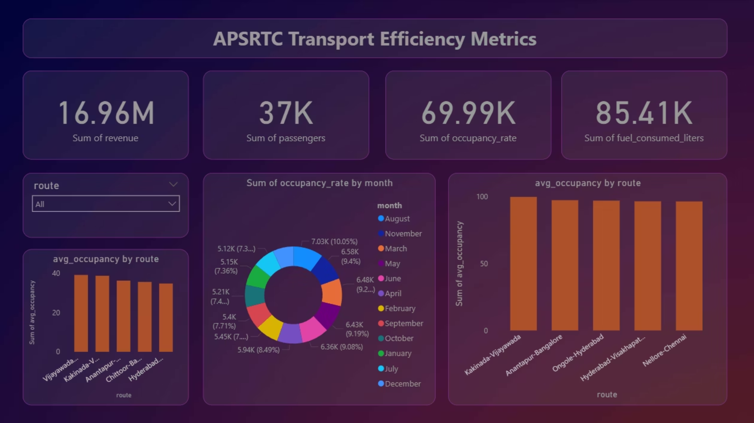
Power BI Dashboard: Actionable Insights

Slide 10
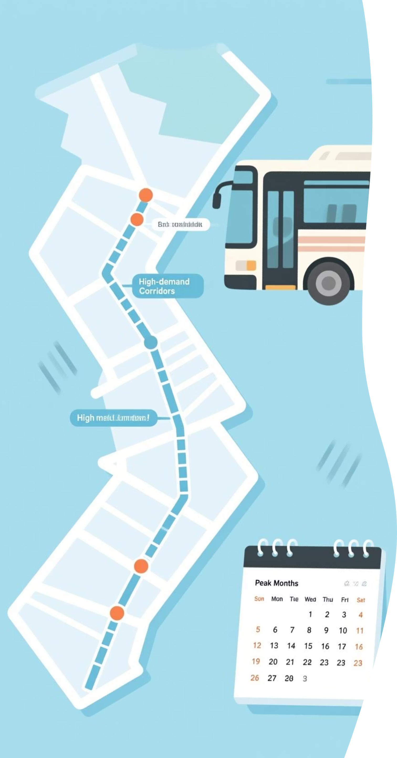
Route Performance Analysis
Kakinada-Vijayawada
High demand route with strong occupancy.
Hyderabad-Visakhapatnam
Key city connection with significant passenger traffic.
Seasonal Patterns
August and May are peak months for demand.
Insights inform route adjustments, resource allocation, and targeted marketing.

Slide 11


Results & Strategic Recommendations
Key Findings
Actionable Recommendations
Major city routes exceed 70% occupancy.
Reallocate fleet to high-demand routes.
August and May show peak passenger demand.
Deploy extra buses during peak months.
Efficient routes have shorter distances, higher occupancy.
Implement monthly performance monitoring.
Integrate driver behavior and fuel tracking.
Fuel consumption patterns reveal optimization.
Impact: Data-driven decisions optimize operations, reduce costs, improve satisfaction, and maximize revenue.

Slide 12

Future Enhancements: ML Integration
Demand Forecasting
Predict passenger demand and seasonal patterns for optimal resource allocation.
Route Optimization
Dynamic route planning and efficient bus/driver allocation based on demand.
Real-time Optimizations
Live traffic analysis, dynamic pricing, and adaptive scheduling for instant responses.

Slide 13
Thank You!

